Slide 1
Suicide
KEMAH HUTCHINSON
CAS 100 SECTION 1

Slide 2
Permanent solution to a temporary problem….
http://www.youtube.com/watch?v=CUcA_wGxWYw

Slide 3
focal points…
Warning Signs
Causes
How to help
Suicide Myths
Facts and Stats

Slide 4
Facts and stats
On average, one suicide occurs every 17 minutes.
On average, a young person (age 15-24) dies by suicide every 2 hours and 12 minutes.
Suicide is the second leading cause of death among college students.
There are approximately 750,000 suicide attempts each year.
An estimated 5 million living Americans have attempted suicide.
More females attempt suicide than males. (3 female attempts for each male attempt.)

Slide 5
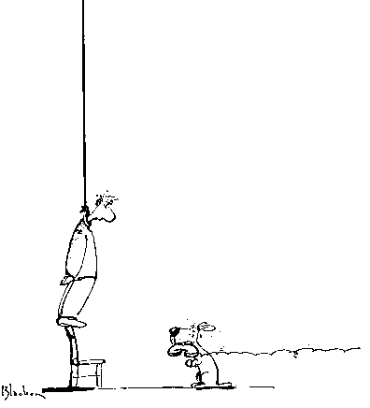
Appearing depressed or sad most of the time.
Talking or writing about death or suicide.
Withdrawing from family and friends.
Feeling hopeless ,helpless, strong anger or rage.
Feeling trapped -- like there is no way out of a situation.
Experiencing dramatic mood changes and exhibiting a change in personality.
WARNING SIGNS

Slide 6
Abusing drugs or alcohol.
Losing interest in most activities.
Experiencing a change in sleeping and eating habits.
Performing poorly at work or in school.
Feeling excessive guilt or shame.
Acting recklessly.
CON’T….

Slide 7
The death of a loved one.
A divorce, separation, or breakup of a relationship.
A serious loss, such as a loss of a job, house, or money.
Chronic physical pain or intense emotional pain.
Being victimized (domestic violence, rape, assault, etc).
Physical, verbal or sexual abuse.
Alcohol or drug abuse.
A feeling of not being accepted by family, friends, or society.
Low self-esteem.
CAUSES

Slide 8
HOW TO GET HELP…
Always take suicidal comments very seriously.
Try not to act shocked.
Get help immediately.
Do not handle the situation by yourself.

Slide 9
Suicide myths…
People who talk about suicide are just trying to get attention.
People who talk about wanting to die by suicide do not try to kill themselves.
Suicide always occurs without any warning signs.
Once people decide to die by suicide, there is nothing you can do to stop them.
People who attempt suicide and survive will not oftentimes make additional attempts.

Slide 10
summary
Warning Signs can be detected
Causes are caused by highly depressing events
Help is available
Knowing suicide myths can help.
Facts and Stats

Slide 11
Help yourself…
Need Help Now? Call 911 or 1-800-SUICIDE (1-800-784-2433) or 1-800-273-TALK (1-800-273-8255) or Text Telephone: 1-800-799-4TTY (1-800-799-4889)

Slide 12
Contact info
Any questions or need more info:
Email: kwh5120@psu.edu

Slide 13
References
Kemah, put the name of the organization, not just the website, the name of the article or articles and date you retrieve the information.
( www.suicide.org)
Also, be credible enough by having 3-5 sources.

